Slide 1
Arrowsmith TSR4
Timber Supply Analysis
Discussion Paper
October 28, 2016

Slide 2
Arrowsmith TSA — AAC History
498,250 m³
392,890 m³
400,000 m³
420,000 m³
Long standing partition (since 1996) for Clayoquot (13,700 m3 and deciduous leading stands (6,300 m3)
Notes:
In 1986, the Arrowsmith TSA was formed from portions of the former Nootka and Quadra TSAs. AAC initially 392890. 1989 3870 added to AAC. 1992, increased to 498250 to account for a land transfer from TFL 46. December 1996 decreased to 400000 (partitioned 13700 Clayoquot, 6300 red-alder leading stands, 380000 outside of clayoquot sound. Sept 2002 set at 373300. 2002 increased to 393496. April 22, 2004 increased to 418796 because of land transfer from TFL44. July 22, 2009 AAC set at 420000.

Slide 3
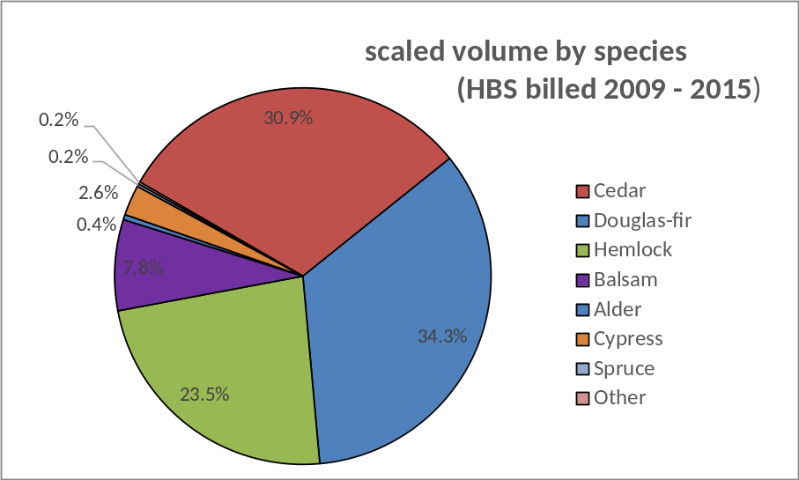
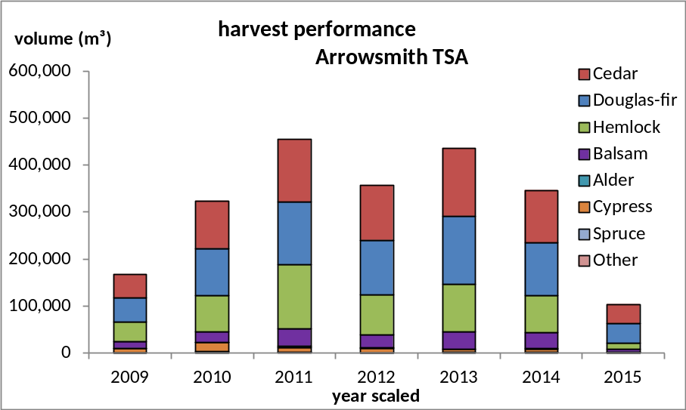
Billed volumes between 2009 and 2015
Species composition
Volume by year

Slide 4
Changes since the last TSR
TSR3 THLB corrections (Barkley CFA, Maa-nulth Treaty lands)
CDF removed
Gulf Islands removed
Empirically based operability
Spatial OGMAs for most LUs
Prov site prod SIs used
BCTS ECA watersheds rate of cut constraints
Mature forest objectives in SMZs
VQOs updated (2011)
Shading & competition factor applied to MSYTs
NRLs increased

Slide 5
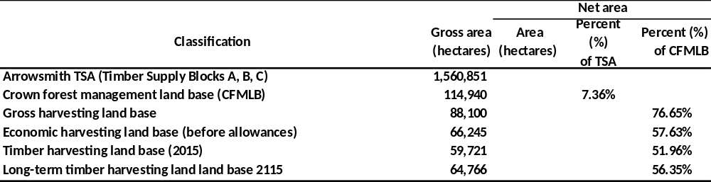
Classification Totals

Slide 6
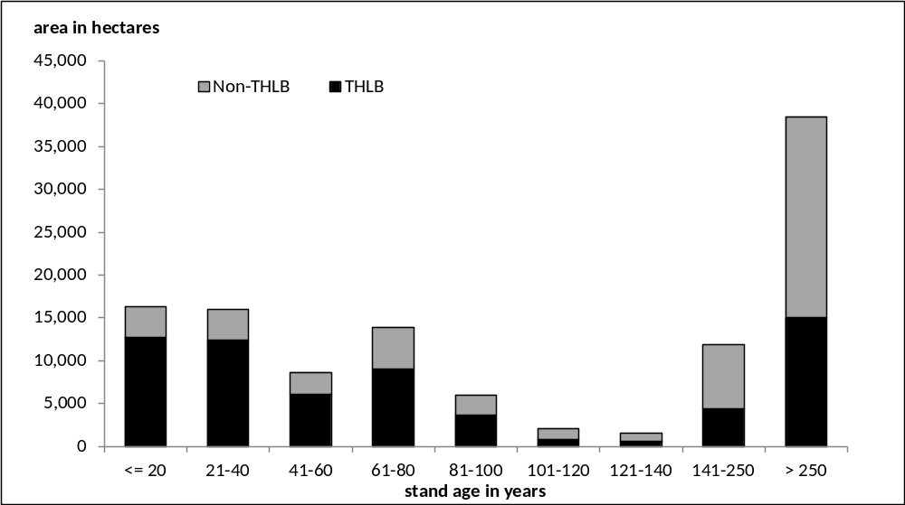
CFMLB age class distribution
Notes:
Age class 6 & 7 lacking. Most age class 8 & 9 on west coast. Cedar and hemlock stands. Non-THLB 8 & 9, spatial OGMAs, wildlife habitat reserves.

Slide 7
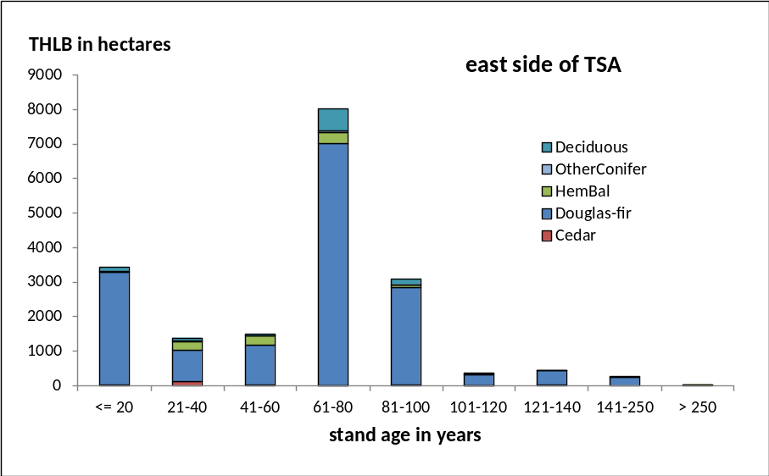
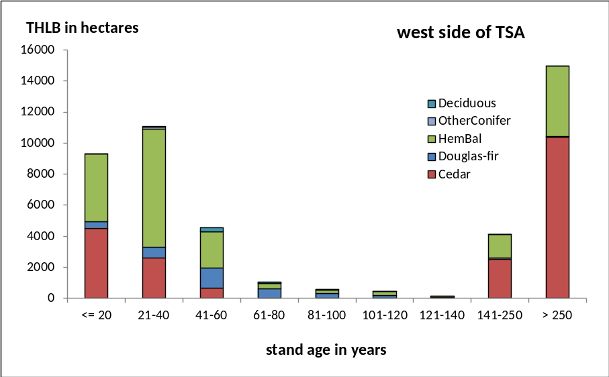
THLB age class distribution east vs west

Slide 8
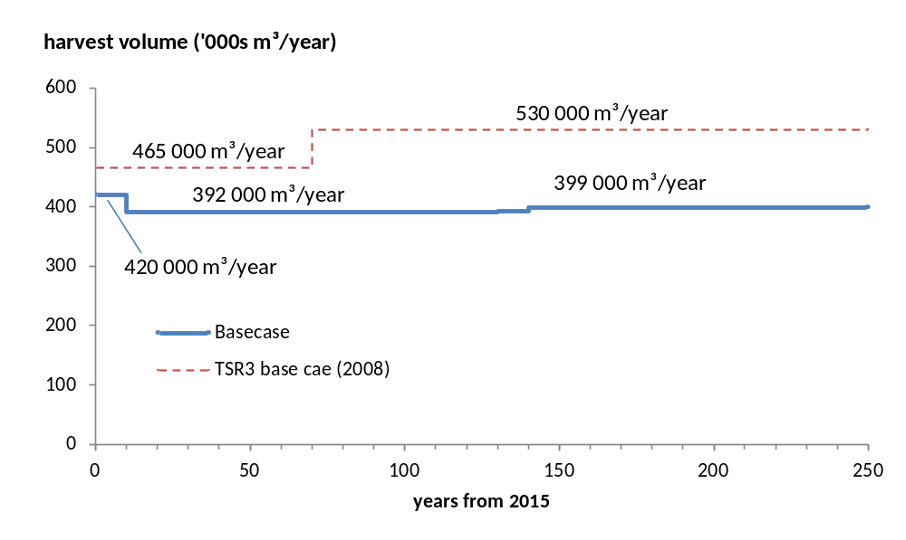
Base case harvest projection
Important modelling criteria
Target to harvest 13,700 m3 from Clayoquot Sound area, 6,300 m³ from red alder stands, 100,000 m³ from east side of TSA. Balance from west side.
Order stands for harvest based on age.
Merchantability based on minimum volume threshold.
350 m3/ha conventional ground
450 m3/ha heli ground
200 m3/ha red alder stands
After 10 years TLs revert, ones having mature timber get harvested before reverting
After 100 years timber in PSPs and research installations contributes to timber supply
Variable retention harvesting only in Clayoquot Sound area

Slide 9
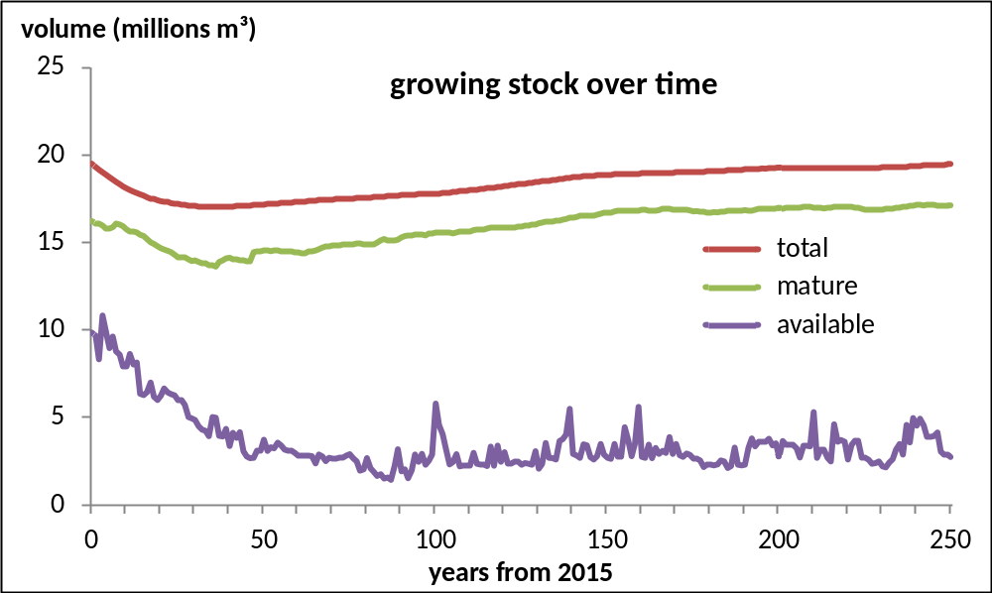
Base case metrics – growing stock over time
Stable total growing stock. Starts at 19.5M, declines to 17M during first 35 years of projection.
Returns to 19.5M by year 150 and stays at that level.
Available growing stock much less due to heavily constrained timber supply. VQOs, BCTS ROC watersheds constraining.

Slide 10
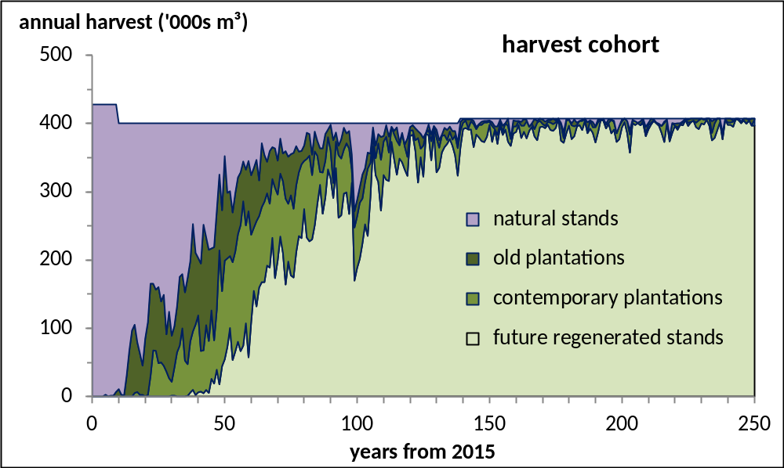
Base case metrics – harvest cohort
The harvest transitions to mainly second growth by 70 years
Harvest of old plantations begins after 5 years
Roughly 30 percent of harvest from stands less than 100 years old to begin with, increases as time goes on

Slide 11
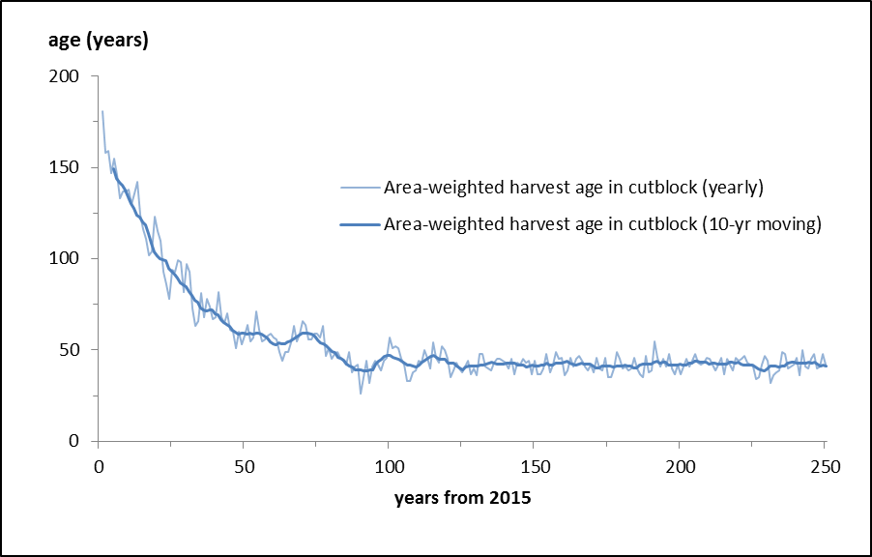
Base case metrics – average harvest age
The average harvest age drops over the first 90 years from 150 years to 44 years before levelling off

Slide 12
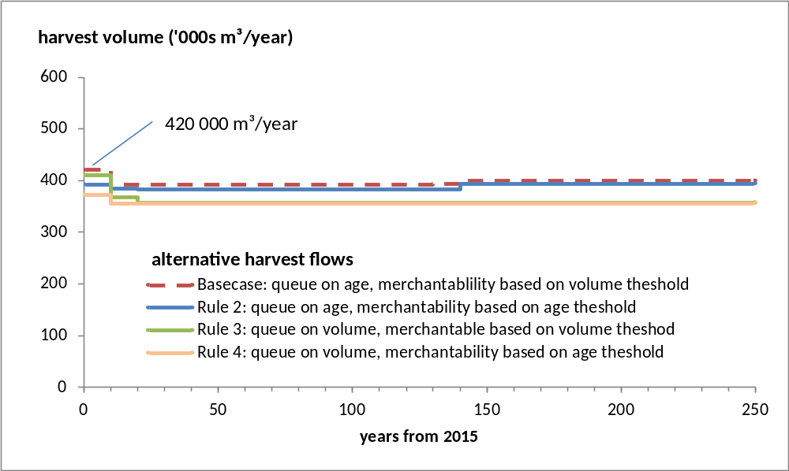
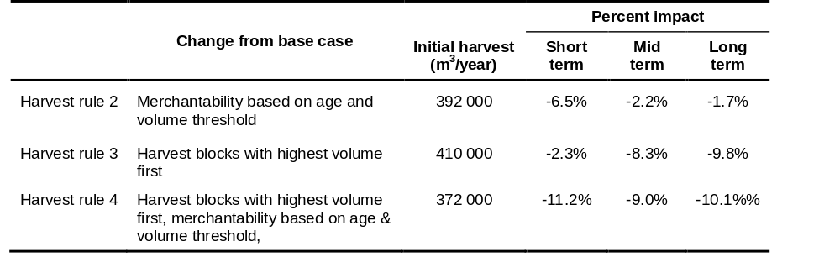
Alternative harvest flows - based on variation in harvest rules
Using age criteria vs volume threshold impacts the short-term, not a big impact on the mid- and long term. Increases mean harvest age by 5 to 7 years
If harvest blocks queued on volume significant impact.

Slide 13
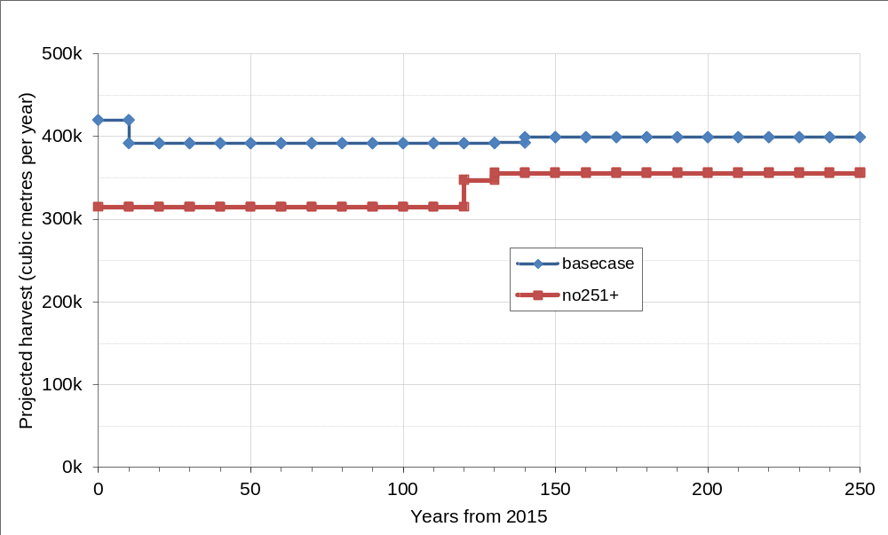
Sensitivity:
No harvesting of old forest ( >250 years old)
What if harvesting of old growth needed to end tomorrow
  Short-term -24.5%
  Mid-term -19.2%
  Long-term -12.6%

Slide 14
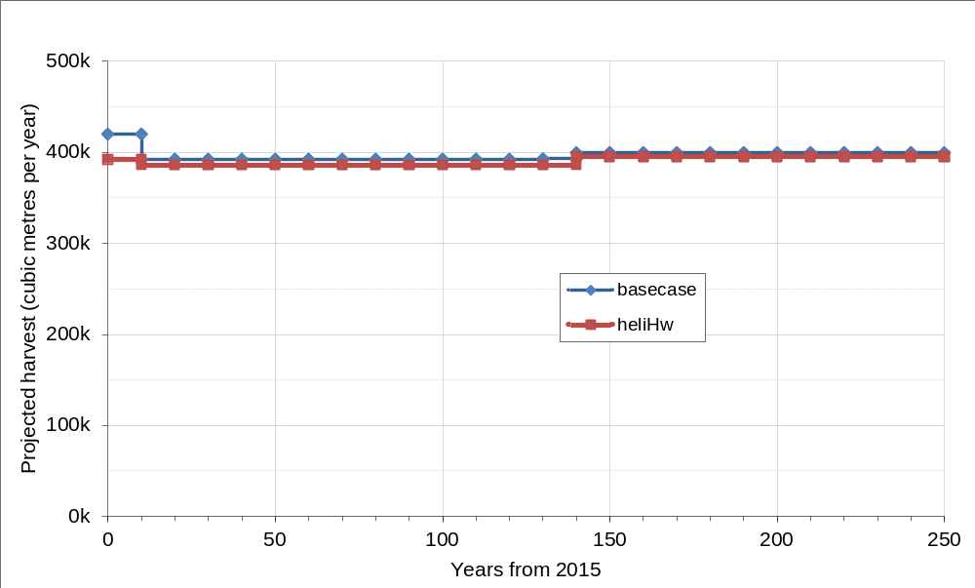
Sensitivity:
Heli hembal stands on west coast having < 20% cedar
Removes 653 ha, equals 1% of THLB.
6.6% short-term
1.5% mid-term
1.2% in long-term

Slide 15
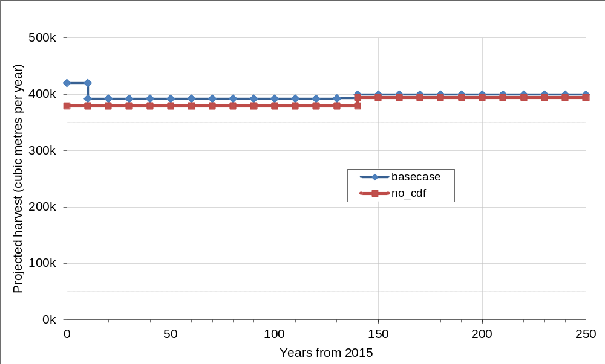
Sensitivity:
Exclude remaining CDF mm from THLB
Removes 900 ha from THLB or 1.4%
Short-term -9.6%
Mid-term -3.3%
Long-term -2.0%

Slide 16
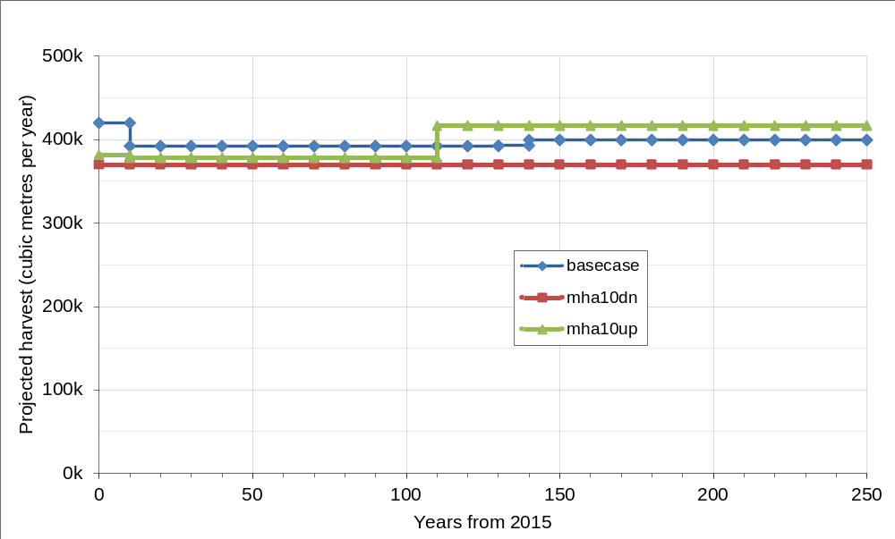
Sensitivity:
Minimum harvestable age
Increase by 10 years
  Short-term -8.9%
  Mid-term -3.5%
  Long-term 3.2%
Decrease by 10 years
  Short-term -11.7%
  Mid-term -5.5%
  Long-term -6.6%

Slide 17
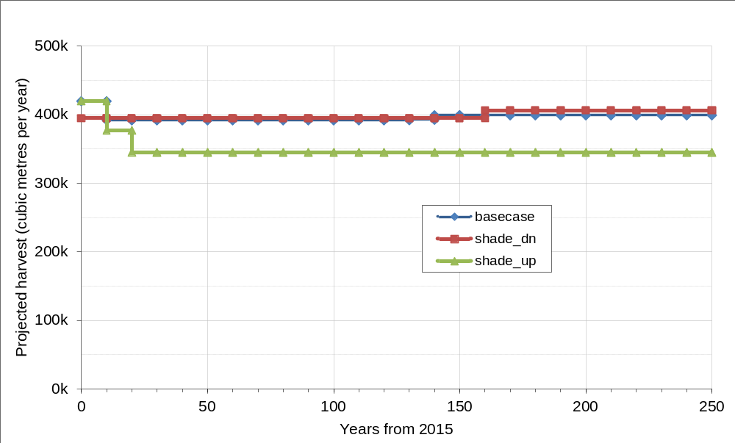
Sensitivity:
Effects of shading & competition in small cut blocks with variable retention
Occurs in SMZs and P, R VQOs covering 10,440 ha of THLB or 16%
Adjust yields by -18% in recent plantations and all future regenerated stands (not just in very constrained areas)
  Short-term NIL
  Mid-term -10.6%
  Long-term -12.8%
No yield adjustment
  Short-term -5.8%
  Mid-term +0.7%
  Long-term +1.0%

Slide 18
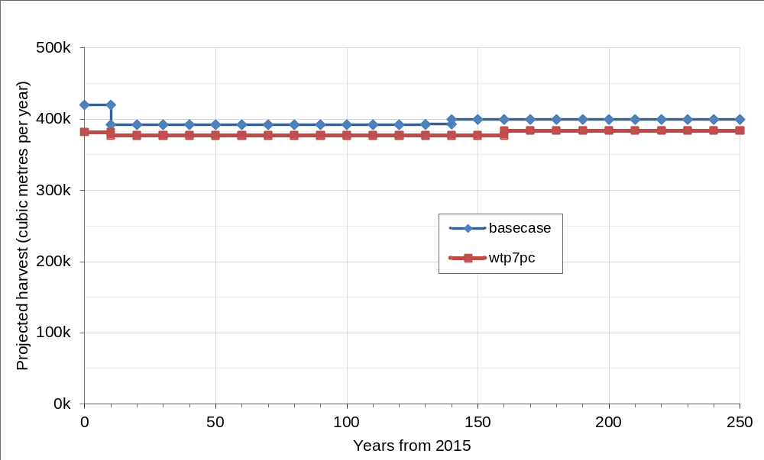
Sensitivity:
In block retention (WTPs)
3.5% within cutblocks, remainder from areas adjacent to cut blocks, other retention
Increase to 7.5%, removes about 900 ha.
  Short-term -8.9%
  Mid-term -3.7%
  Long-term -4.0%

